Slide 1



IB Parent Alliance
Supporting Students. Building Community.
Inspiring Global Citizens

Slide 2
IBPA Restructure - Why
Expanding opportunities for parents to play meaningful roles in supporting students and our school community.
Aligning our IBPA with IB values of collaboration, shared responsibility, and community engagement.
Strengthening the partnership between school and families to support student success academically, socially, and personally.
Ensuring that our families feel valued as essential partners.

Slide 3
IBPA Restructure – Working Together
Families bring valuable perspectives, experiences, talents, and expertise that help enhance our program.
New involvement opportunities will allow families to contribute based on their interests, skills, and availability.
Together, we can build a stronger, more supportive IB learning community.
  Shared goal: empowering students to thrive and make a positive difference in the world.
  Your voice matters. Your partnership matters. Together, we make our IB community stronger.

Slide 4
Mission and Vision
To support Southeast High School as an IB World School by fostering community, celebrating student achievement, enhancing learning opportunities, and providing financial support through meaningful partnerships.
To create a welcoming community where every family feels connected and every student feels supported.

Slide 5
Core Values
International Mindedness
Service
Community
Student Success
Teacher Support
Academic Excellence

Slide 6
Leadership Team
Provide overall direction, support committee chairs, facilitates communication with the IB Coordinator and school administration, and to help ensure the IBPA fulfills its mission of supporting IB students, families, and staff
Chair - Provides leadership for the Parent Alliance, facilitates meetings, coordinates with the IB Coordinator, supports committee chairs, and helps guide annual goals and initiatives.
Secretary - Maintains meeting agendas and minutes, manages official records, tracks action items, and assists with organizational communication.
Treasurer - Maintains financial records, prepares financial reports, oversees the budget, and monitors fundraising income and expenditures.

Slide 7
Committees
Each committee is led by a Committee Chair and may include as many parent volunteers as needed.
Committee Chairs work collaboratively with the IBPA Leadership Team and the IB Coordinator to support the goals of the IB Parent Alliance.
Communications & Membership
Student & Family Engagement
Teacher Appreciation & Community Partnerships
Fundraising & Finance

Slide 8

Communication & Membership
Keep families informed, connected, and engaged throughout the school year.
Responsibilities
  Welcome new IB families
  Coordinate newsletters and announcements
  Manage social media or parent communication platforms
  Recruit and coordinate volunteers
  Promote Parent Alliance meetings and events

Slide 9
Student & Family Engagement
Build community and celebrate student milestones and achievements.
Responsibilities
  Coordinate hospitality for meetings and events
  Support Senior Pinning Ceremony and Diploma Celebration
  Recognize student accomplishments
  Coordinate alumni involvement
  Organize exam encouragement activities and family events

Slide 10
Teacher Appreciation & Community Partnerships
Strengthen relationships with teachers and community partners while supporting the IB Program
Responsibilities
  Coordinate teacher appreciation activities
  Develop local business partnerships and sponsorships
  Identify guest speakers and career connections
  Support CAS and community service opportunities

Slide 11
Fundraising & Finance
Generate financial support for the IB Parent Alliance and IB initiatives.
Responsibilities
  Plan and organize fundraising events
  Seek donations and sponsorships
  Coordinate merchandise opportunities
  Recommend funding priorities
  Assist with scholarship or student support initiatives

Slide 12
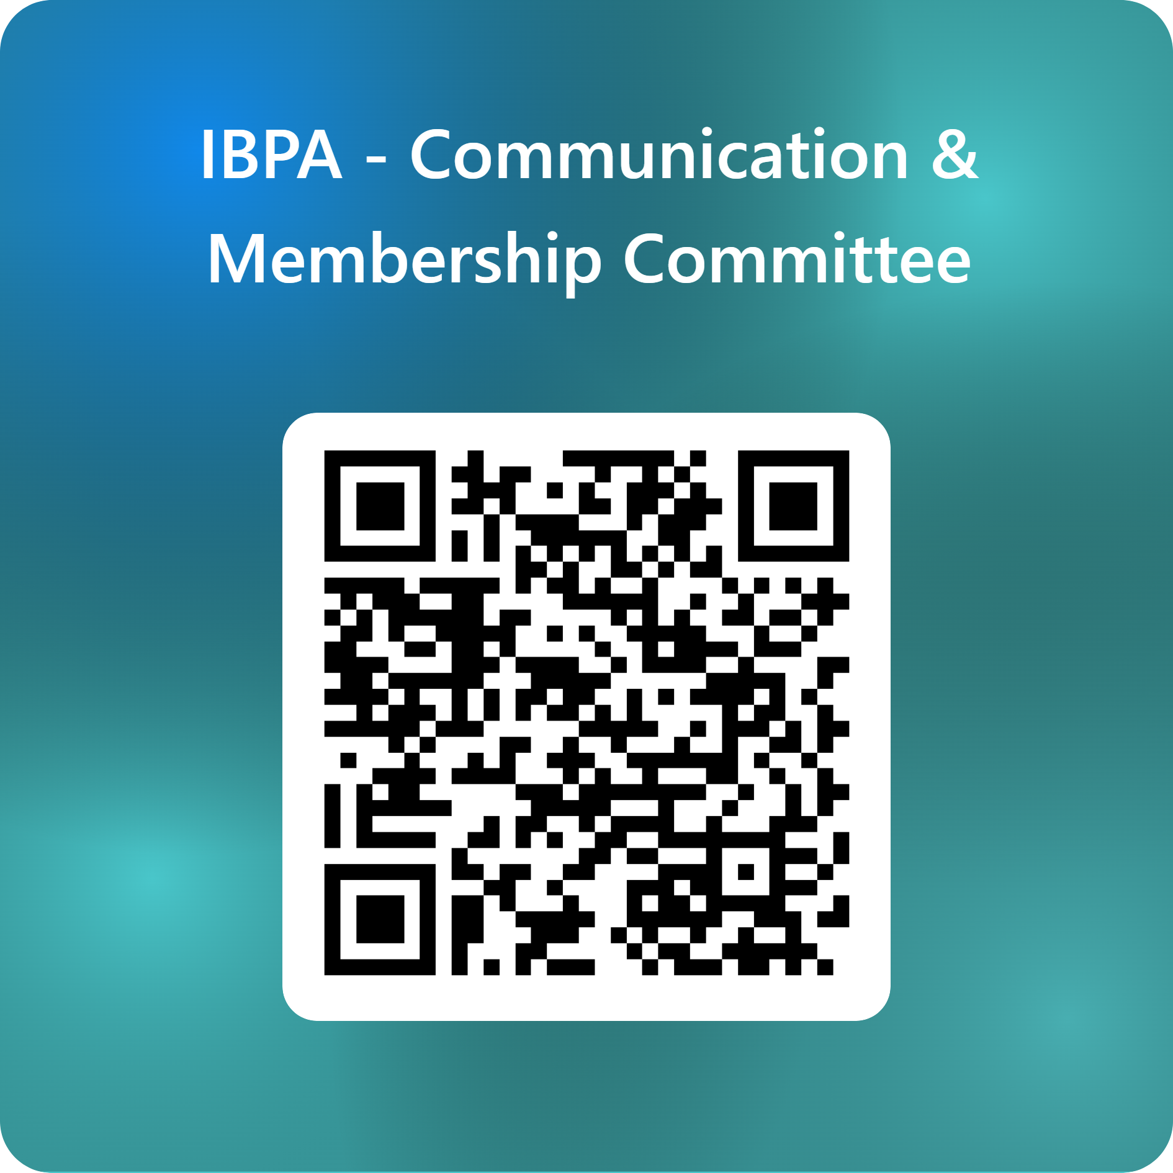
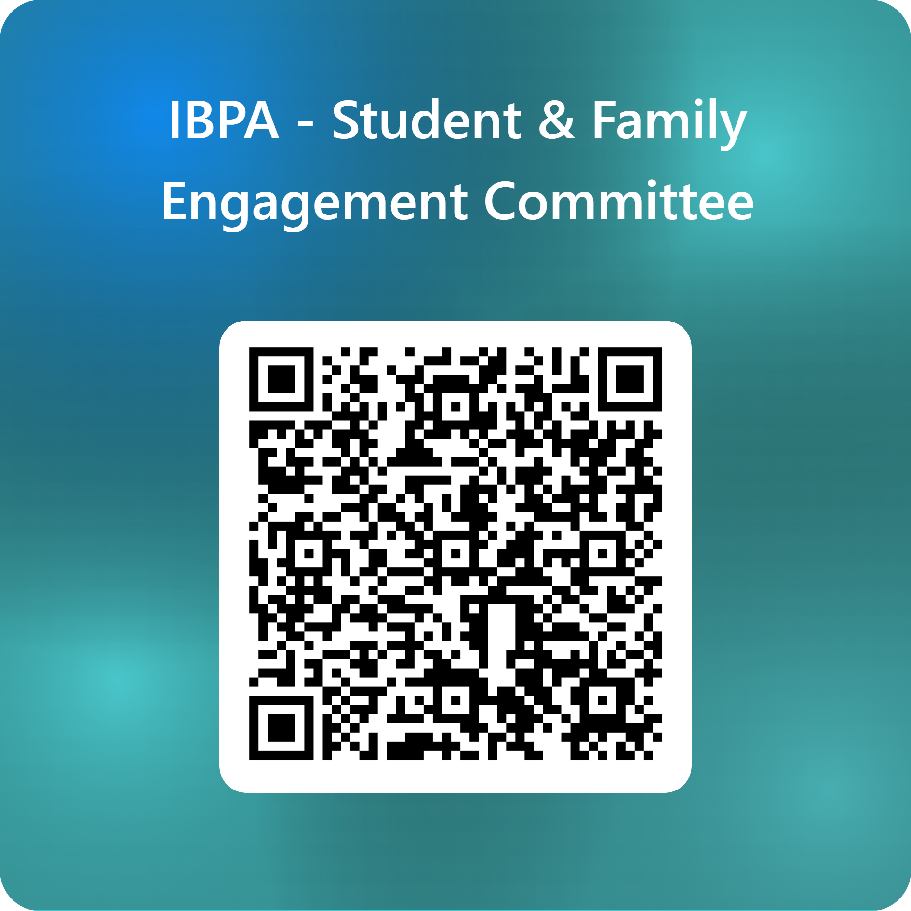
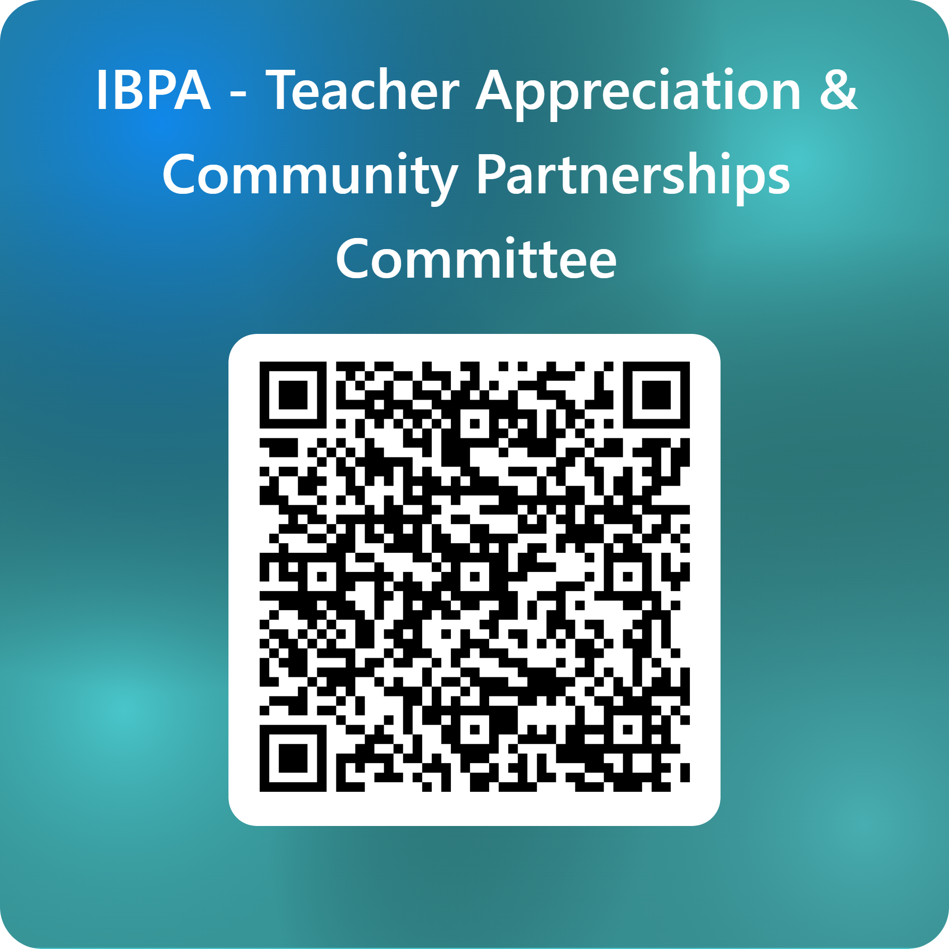
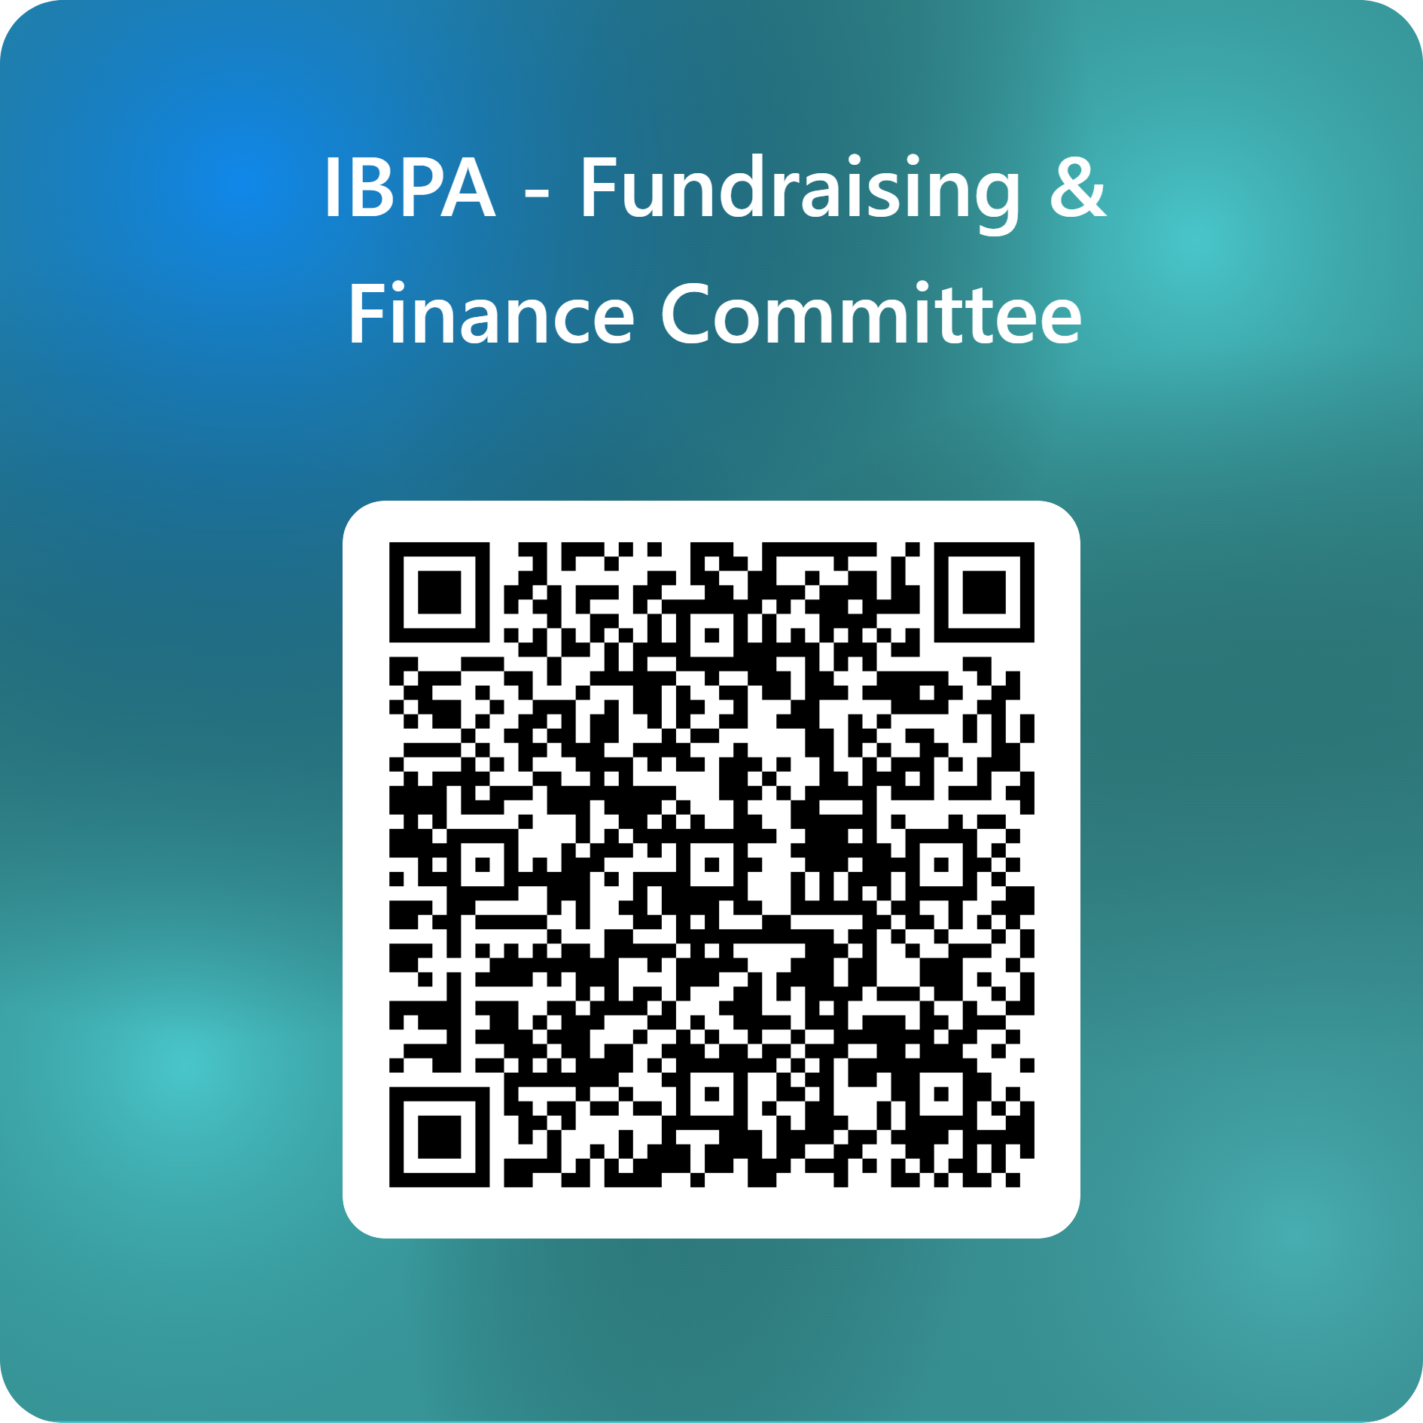
Committee Sign Up

